Slide 1


Statistical Timing Verification for Digital Circuits
Electrical & Computer Engineering
By Ethan Zhou & Neupane Nitesh
3/25/2025

Slide 2

Motivation & Background
Why is Timing Verification Important?
In modern digital circuits, ensuring correct timing is crucial for reliable operation. Pipelined designs rely on strict timing constraints to ensure data is processed correctly at each clock cycle. Any delay that exceeds the allocated time can lead to incorrect computations or system failures. Traditional timing analysis methods aim to guarantee that all paths meet their timing requirements, but they often rely on worst-case assumptions, which can lead to overly conservative designs and unnecessary performance limitations.
Why Statistical Verification?
Traditional worst-case timing analysis assumes fixed delays, ignoring variations due to process, voltage, and temperature fluctuations. In reality, timing delays follow probability distributions, meaning that some violations may be rare but not impossible. Statistical timing verification models these uncertainties, allowing us to estimate the likelihood of timing failures rather than assuming the worst-case scenario. This enables designers to push performance limits more aggressively while maintaining reliability, balancing risk and efficiency in modern high-speed circuits.
ELECTRICAL & COMPUTER ENGINEERING
GRAINGER ENGINEERING

Slide 3
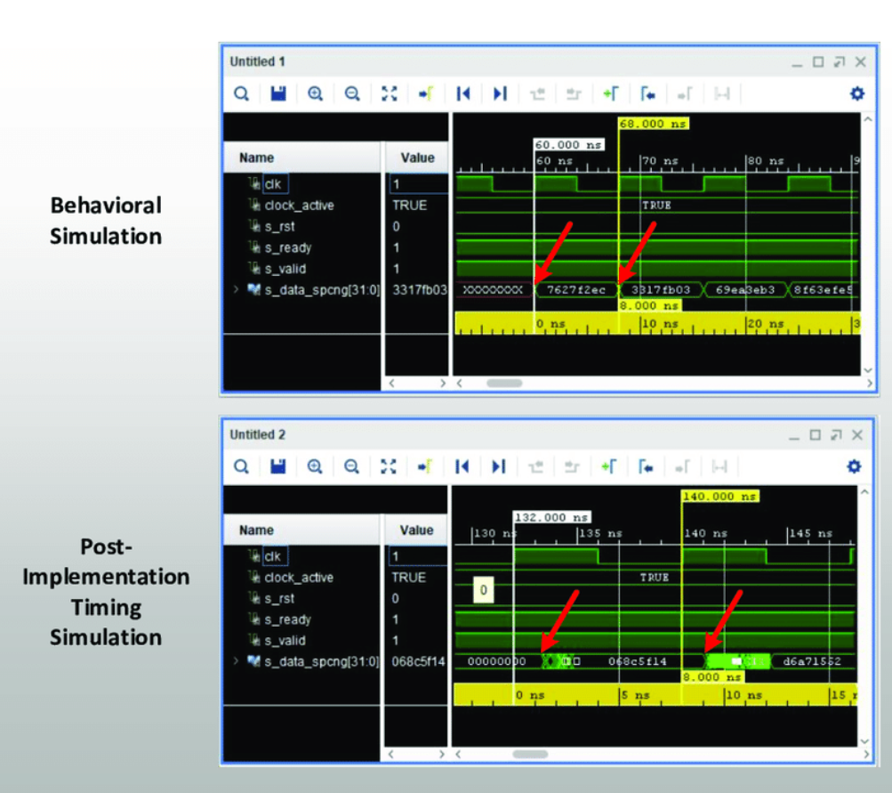
Prior work
Traditional Timing Analysis (STA)
Determines worst-case timing paths to ensure circuit correctness.
Assumes fixed delays, leading to overly conservative designs.
Statistical Timing Analysis (SSTA)
Accounts for variations in process, voltage, and temperature.
Models timing delays probabilistically to estimate failure likelihood.
Key Research in SSTA (Based on proposal references)
Liou et al. (2005, ICCAD): Proposed a unified framework for statistical timing analysis that considers coupling effects and multiple input switching. This method improves accuracy in predicting real-world timing behavior.
Kuo & Ko (2012, ISPACS): Explored low-power design strategies using static and statistical timing analysis. Their work highlights how statistical models can optimize power consumption without sacrificing reliability.
Naidu (2007, VLSID): Focused on speeding up Monte Carlo simulation for statistical timing analysis. This approach improves efficiency, making statistical verification more practical for large-scale circuits.
Jyu et al. (1993, VLSI Systems): One of the early works in statistical timing analysis for combinational logic, laying the foundation for probabilistic verification techniques.
Li et al. (2013, IEEE TCAD): Investigated hierarchical statistical timing analysis, which improves scalability by breaking circuits into smaller components while maintaining accuracy.
IMAGE / GRAPHIC
ELECTRICAL & COMPUTER ENGINEERING
GRAINGER ENGINEERING

Slide 4
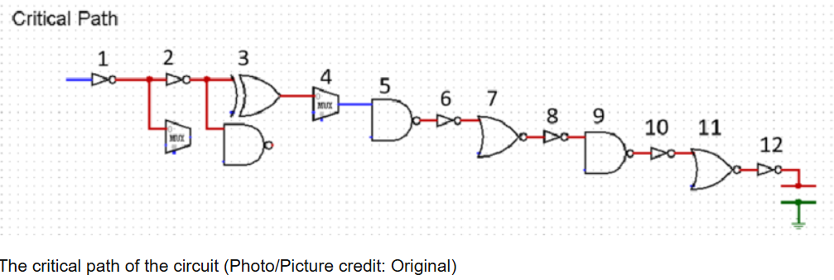
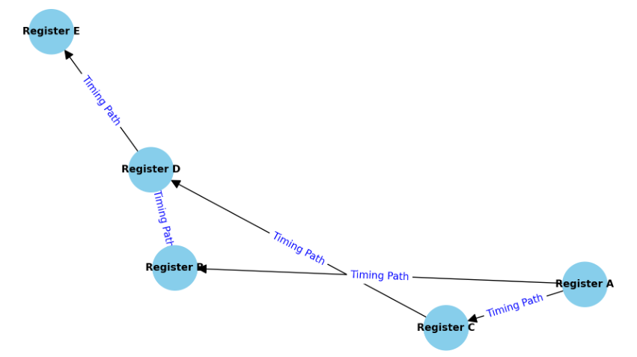
Definition of the Verification Problem
Problem Statement
In pipelined digital circuits, timing violations occur when signal propagation exceeds the allocated clock cycle.
Traditional worst-case analysis is too conservative and inefficient.
Need a probabilistic approach to estimate the likelihood of timing failures instead of assuming the worst case.
Our Approach
Model the circuit as a directed graph:
Nodes: Pipelined registers.
Edges: Timing paths with delay modeled as probability distributions.
Verification goal: Ensure that the probability of a timing path exceeding its slack remains below a given threshold.
IMAGE / GRAPHIC
IMAGE / GRAPHIC
ELECTRICAL & COMPUTER ENGINEERING
GRAINGER ENGINEERING

Slide 5
Why choose this approach?
Comprehensive Uncertainty Management: This method effectively accounts for variations caused by manufacturing processes, voltage fluctuations, and temperature changes, ensuring a more robust design.
Realistic Timing Estimation: Unlike traditional worst-case analysis, this approach provides a precise quantification of the actual risk of failure, offering a more accurate and practical assessment.
Enhanced Performance Optimization: It empowers designers to maximize clock speeds while ensuring reliability remains within acceptable limits, striking an optimal balance between performance and dependability.
ELECTRICAL & COMPUTER ENGINEERING
GRAINGER ENGINEERING

Slide 6
Proposed Algorithm
Graph-Based Model for Timing Verification
Represent the digital circuit as a directed graph:
Nodes: Registers in the pipeline.
Edges: Timing paths with probabilistic delay distributions.
Goal: Compute the probability of a path exceeding its allocated slack
Monte Carlo Simulation for Statistical Timing Analysis
Instead of a single worst-case delay, generate multiple delay samples based on probability distributions.
Run thousands of iterations to estimate the likelihood of timing violations.
Provides a more accurate picture of circuit behavior under real-world conditions.
ELECTRICAL & COMPUTER ENGINEERING
GRAINGER ENGINEERING

Slide 7


Thank you
Q&A

